Slide 1
ICD2O Workshop 2
How to create your Maze of Learning!

Slide 2
Skills we'll be going over
Drawing the maze (in CORNERS mode) and creating the maze traveller
Collision detection in the maze
Key input for the maze traveller
Creating a pop-up textbox

Slide 3
Download the code
Copy the following URL and download the files so that you can follow along and do the hands-on activities!
Download BOTH FILES. The file that says STUDENT does not have the full code/answers while the other one does! We'll be starting with the STUDENT file but you'll need the full one later.
tinyurl.com/icsmazedemo

Slide 4
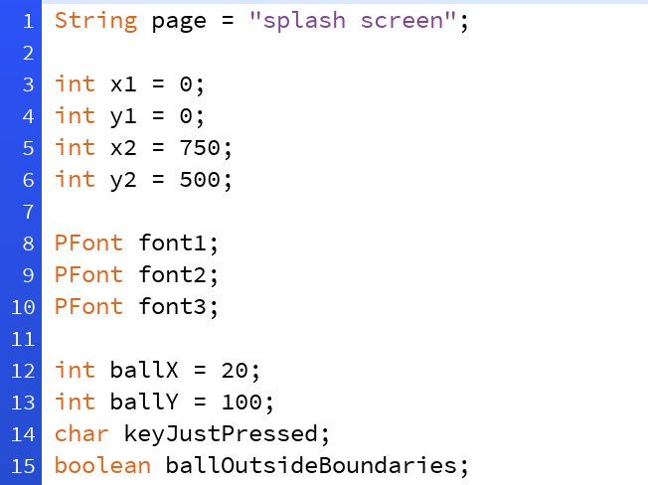
Getting Started
ballX, ballY, keyJustPressed, and ballOutsideBoundaries are the new global variables.
ballX and ballY will control the x and y coordinates of our maze traveller.
ballOutsideBoundaries will be used for collision detection.
keyJustPressed will help the maze traveller smoothly go through the maze.

Slide 5
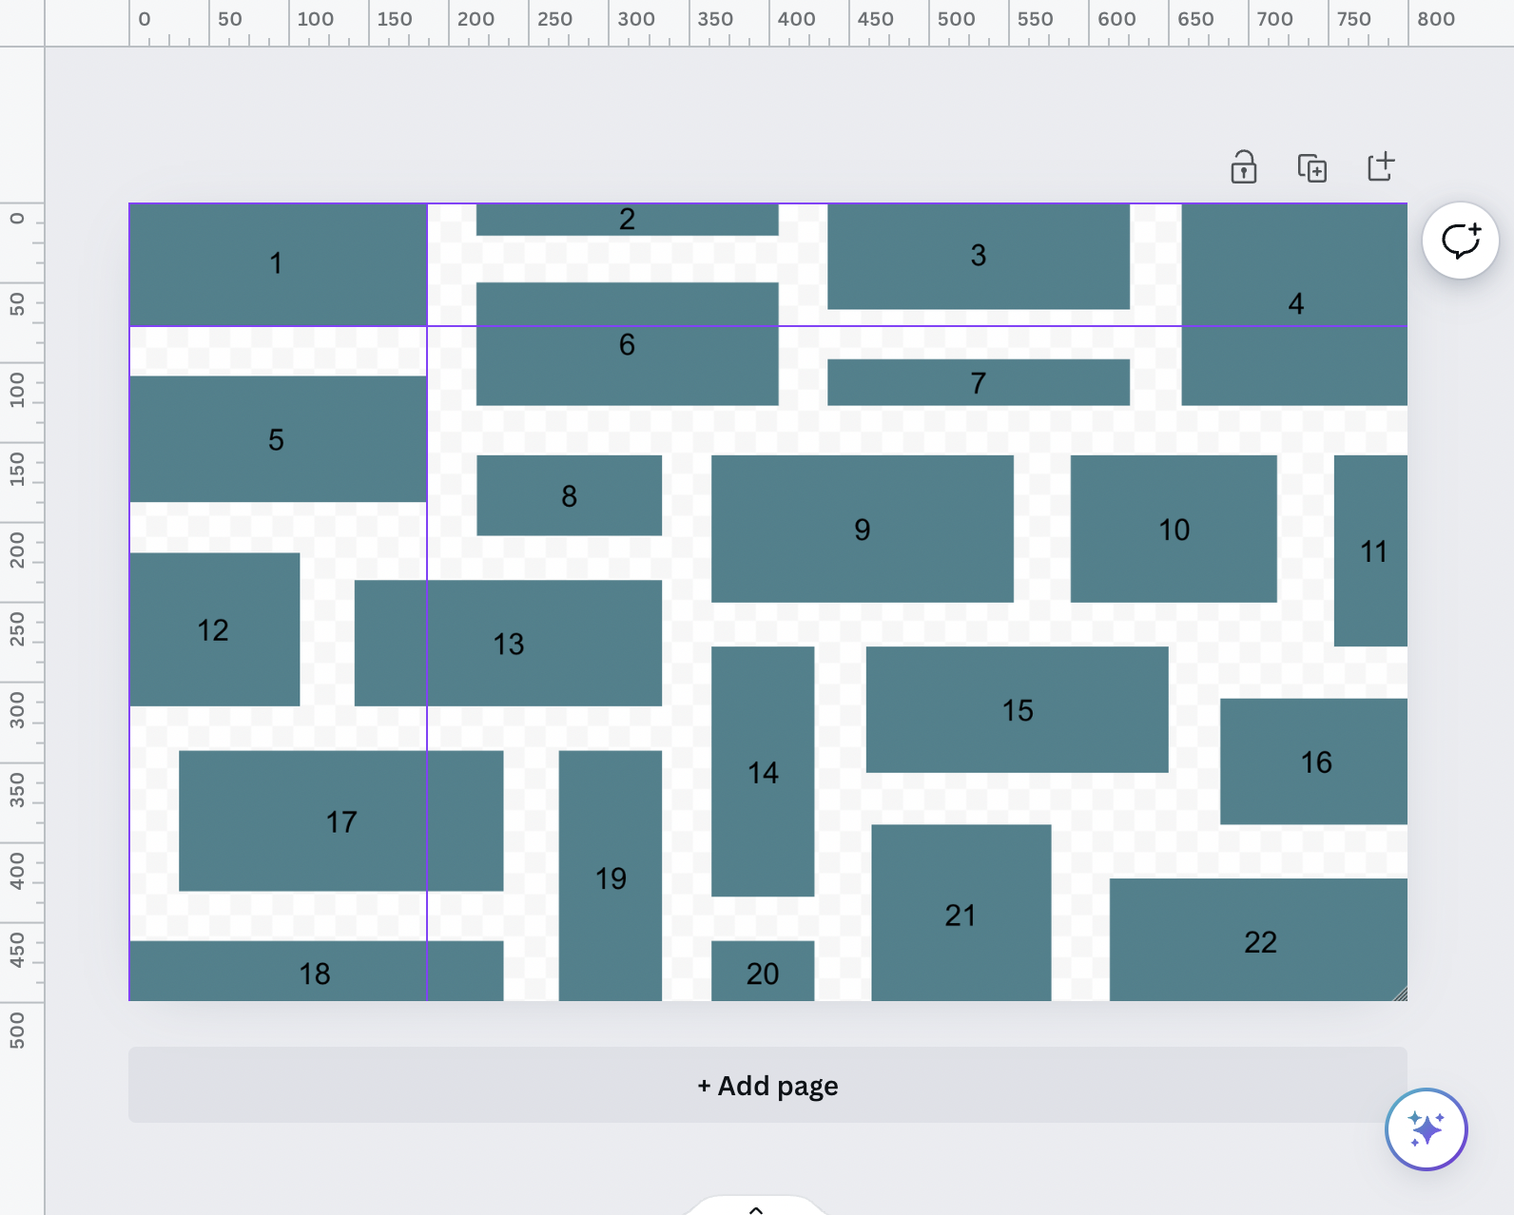
Drawing the Maze
Use Canva to plan it out.
Put Processing into rectMode(CORNERS).
Now when you make a rectangle, the arguments will be rect(topleft-x, topleft-y, bottomright-x, bottomright-y)
This rectangles mode will help us later with collision detection.

Slide 6
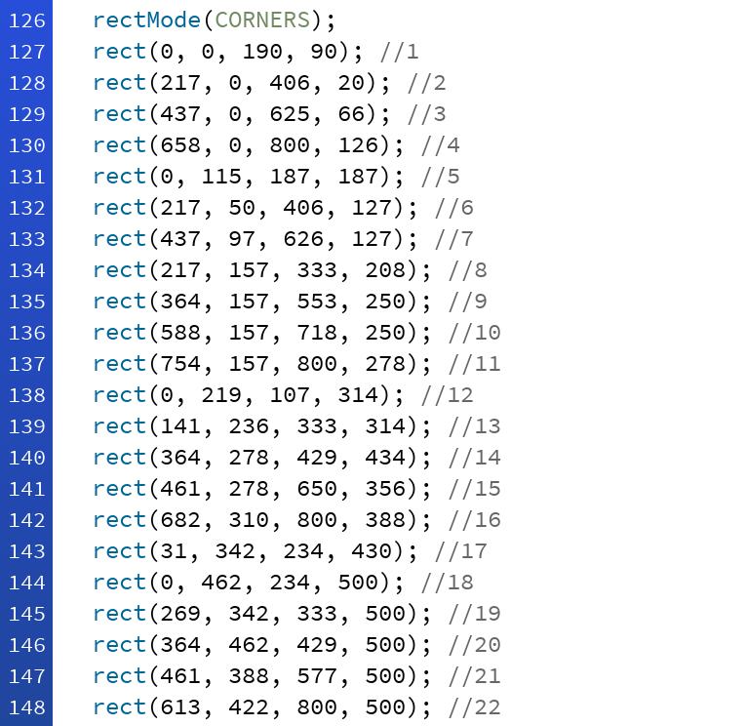
Drawing the Maze
Use Canva to plan it out.
Put Processing into rectMode(CORNERS) in the maze() method.
Now when you make a rectangle, the arguments will be rect(topleft-x, topleft-y, bottomright-x, bottomright-y)
This rectangles mode will help us later with collision detection.

Slide 7
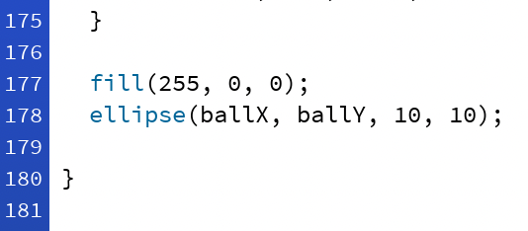
Maze Traveller
Just some shape that goes through your maze that the user can control with arrow keys.
Can be a more complex character
In our demo, it's just a red ellipse
Important: ballX and ballY will be the x and y coordinates of our maze traveller.
Changing ballX and ballY will move our maze traveller.

Slide 8
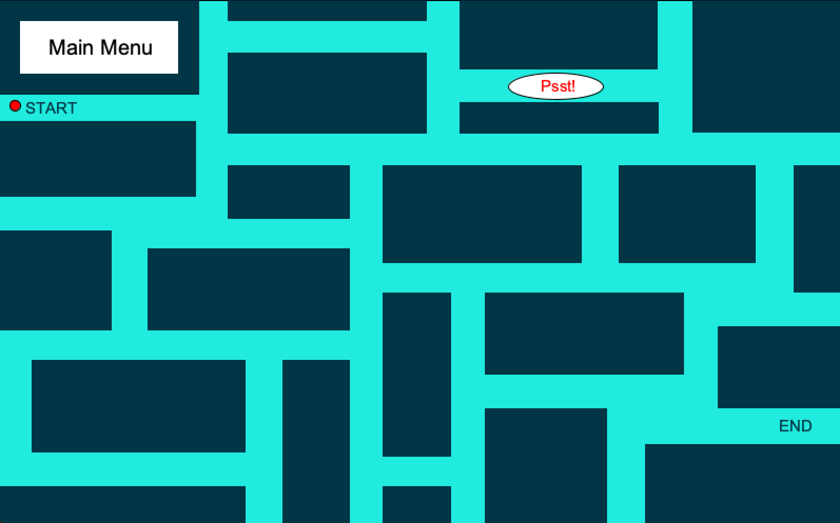
Collision Detection
Before we start coding key input to move our maze traveller, we need to do some collision detection!
Remember all those rectangles we drew? The maze traveller needs to travel BETWEEN those rectangles.
If the maze traveller hits any of those rectangles, it should stop moving!

Slide 9
Collision Detection
Use the variable ballOutsideBoundaries
ballOutsideBoundaries should be TRUE if our maze traveller goes into any of the dark green rectangles
Remember that ballX and ballY are the coordinates of the maze traveller

Slide 10
Collision Detection
This means that the MOST DIFFICULT PART is checking if (ballX, ballY) is inside any of the dark green rectangles.
To do this, check for each rectangle:
  ballX > left edge
  ballX < right edge
  ballY > top edge
  ballY < bottom edge

Slide 11
Collision Detection
For example, for the top right rectangle, we're checking:
  ballX > 0
  ballX < 190
  ballY > 0
  ballY < 90
We drew this rectangle by doing: rect(0, 0, 190, 90)

Slide 12
Collision Detection → Hands-On
We must do this for ALL 22 rects!
Try doing it for the skinny rectangle on the right of the previous rectangle. Add it to the code where indicated.
Answer: (ballX > 217 && ballX<406 && ballY > 0 && ballY<20)

Slide 13
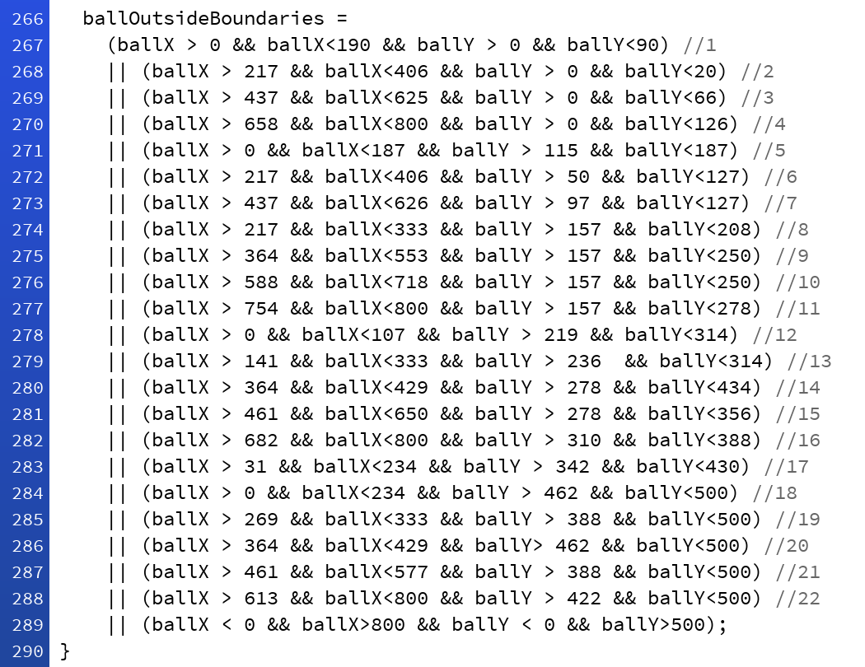
Collision Detection
Now go to the PDE file that does NOT say "student" in the file name.
Find the giant block as shown on the right.
Copy and paste it into your PDE file that has "student" in the file name.
ballOutsideBoundaries (a boolean variable) will be TRUE if the maze traveller is inside ANY of the dark green rectangles.

Slide 14
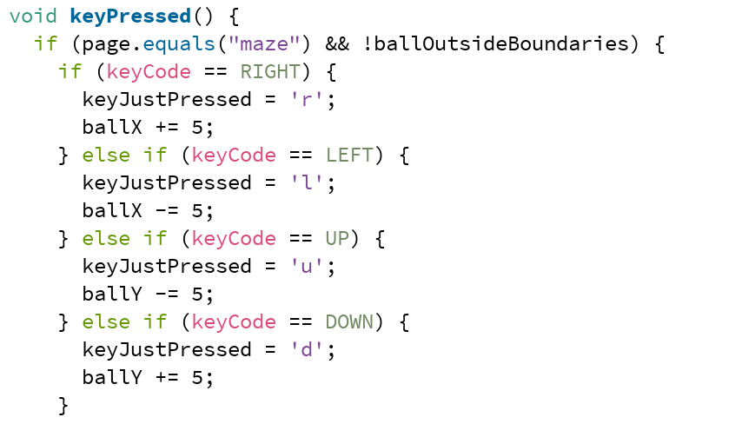
Key Input for Maze Traveller
We will be using the built-in Processing method void keyPressed() and the built-in variable keyCode
Depending on which arrow key you press, record that down in keyJustPressed and adjust ballX and ballY accordingly.

Slide 15
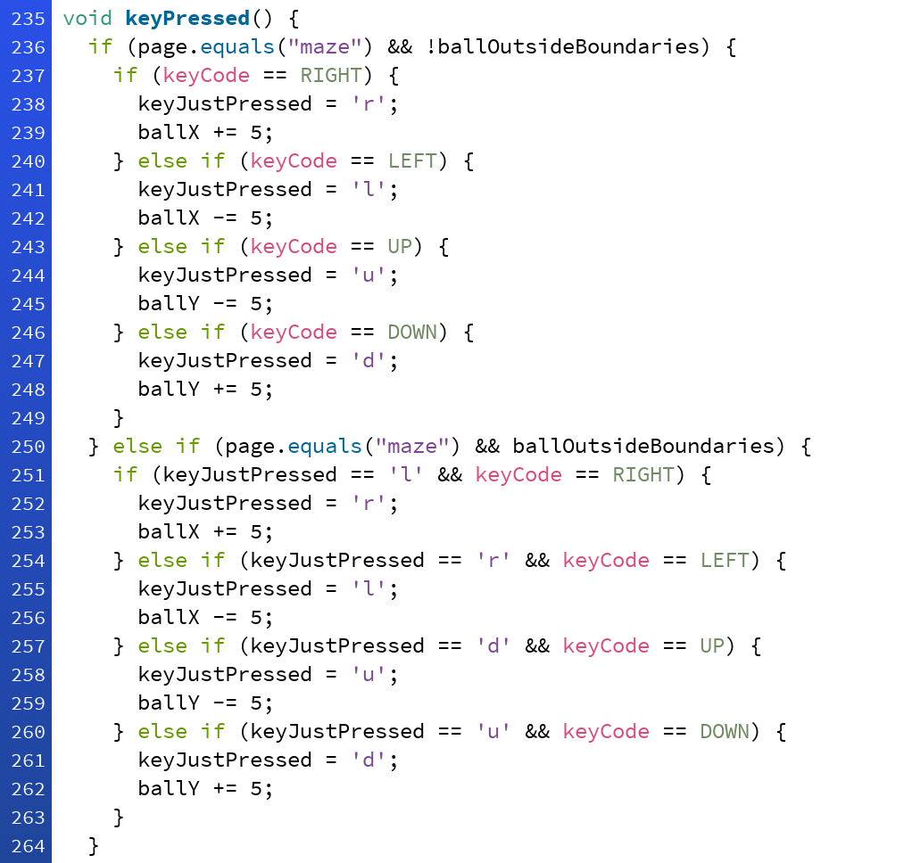
Key Input for Maze Traveller
But wait! What happens when my ball accidentally hits a rectangle? How can I get it moving again?
That's what the second part is for!
If you JUST PRESSED the left arrow key and bumped into a rectangle, you should be able to get out using the opposite arrow key (right)!

Slide 16
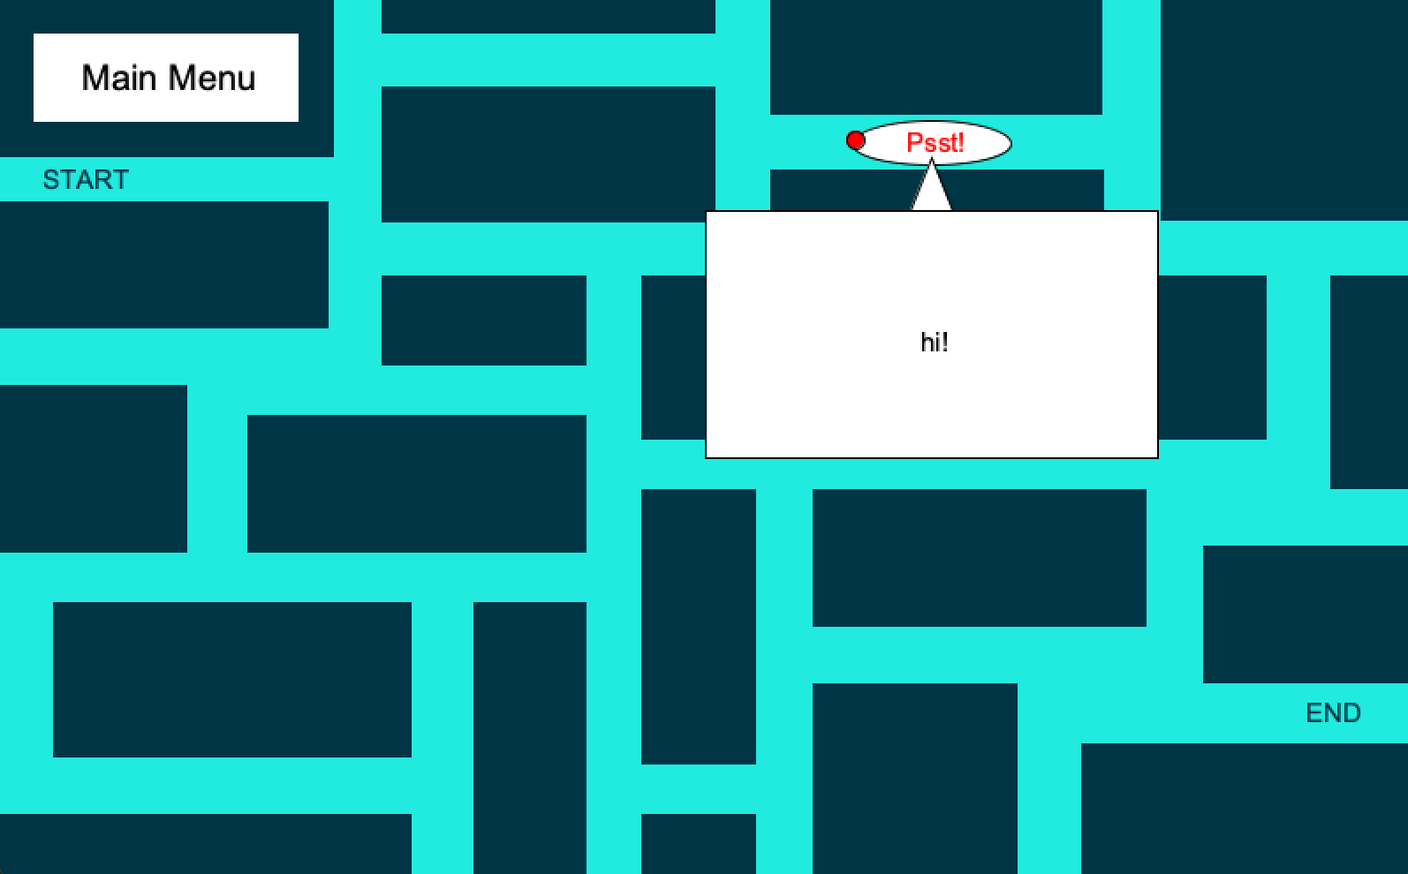
Creating a Pop-Up Textbox
See where it says "Psst!"?
We're going to write some code so that, if the maze traveller hits that "Psst!" ellipse, a textbox will show up.
As soon as the maze traveller leaves that ellipse, the textbox should disappear.
You can use this format to teach the user lessons in a fun way!

Slide 17
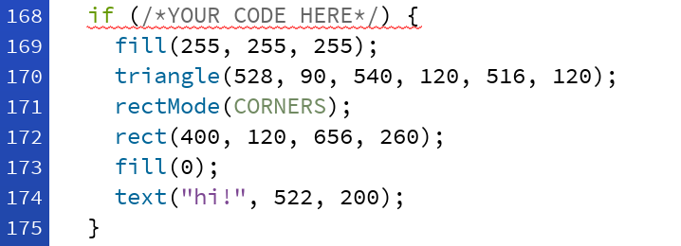
Creating a Pop-Up Textbox → Hands-On
Go to you STUDENT file and scroll to the maze() method.
This textbox will work with collision detection!
ONLY WHEN you maze traveller is TOUCHING the ellipse, this textbox will show.
Use an if statement!

Slide 18
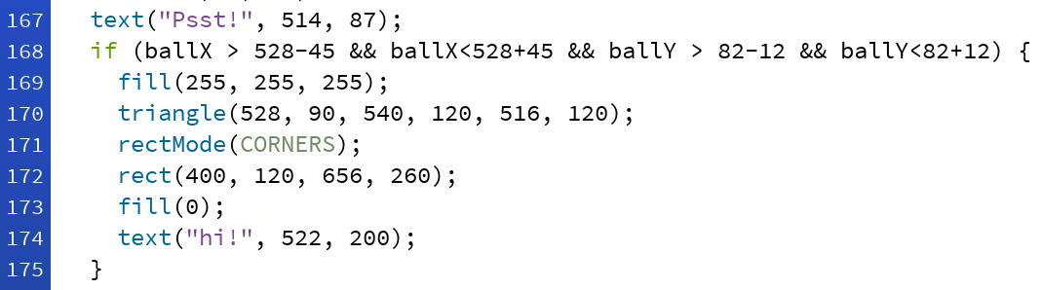
Creating a Pop-Up Textbox
Remember! We're checking:
  ballX > left edge
  ballX < right edge
  ballY > top edge
  ballY < bottom edge
With our ellipse
  left edge: 528 - 45
  right edge: 528 + 45
  top edge: 82 - 12
  bottom edge: 82 + 12

Slide 19
Thank you for coming!

